Slide 1
Distributed and Cloud Computing
K. Hwang, G. Fox and J. Dongarra
Chapter 3: Virtual Machines and Virtualization of Clusters and datacenters
Adapted from Kai Hwang
University of Southern California
March 30, 2012

Slide 2
Virtualization for Datacenter Automation
to serve millions of clients, simultaneously
Server Consolidation in Virtualized Datacenter
Virtual Storage Provisioning and Deprovisioning
Cloud Operating Systems for Virtual Datacenters
Trust Management in virtualized Datacenters

Slide 3
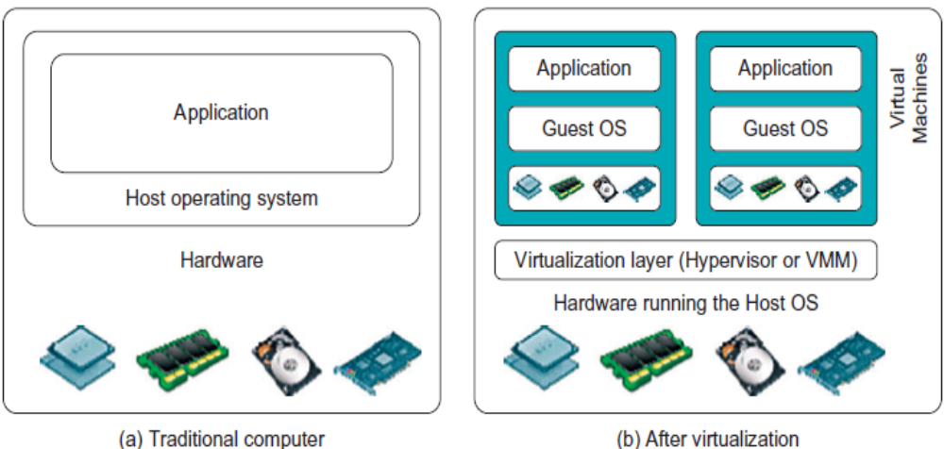
Difference between Traditional Computer and Virtual machines
(Courtesy of VMWare, 2008)

Slide 4
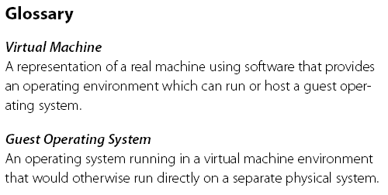
Virtual Machine, Guest Operating System, and VMM (Virtual Machine Monitor) :
The Virtualization layer is the middleware between the underlying hardware and virtual machines represented in the system, also known as virtual machine monitor (VMM) or hypervisor.

Slide 5
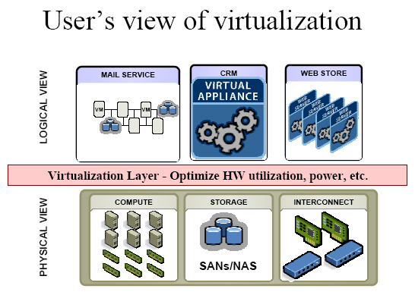
(Courtesy of VMWare, 2008)

Slide 6
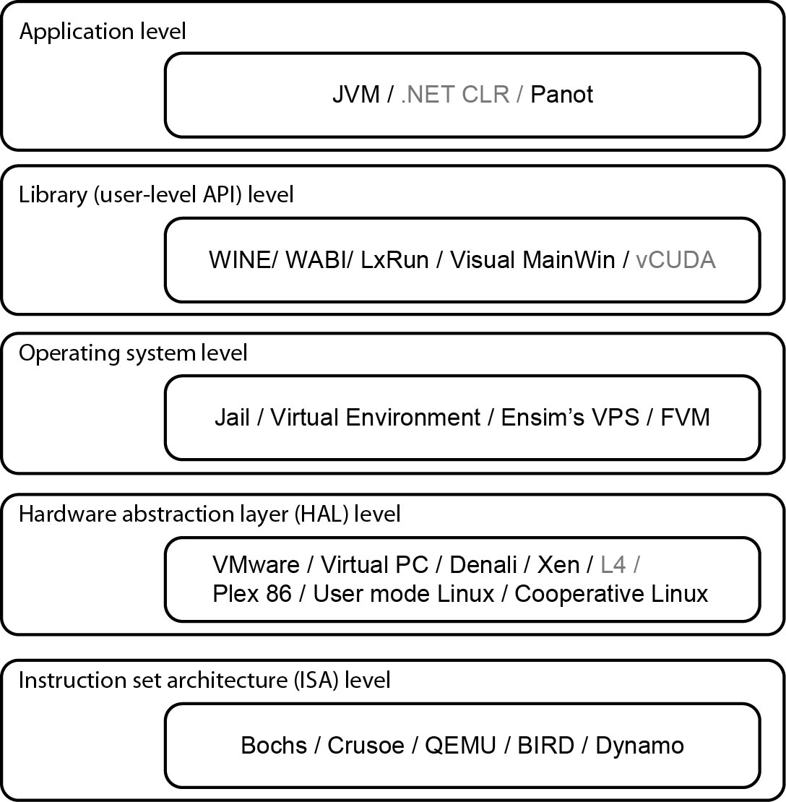
Virtualization Ranging from Hardware to Applications in Five Abstraction Levels

Slide 7
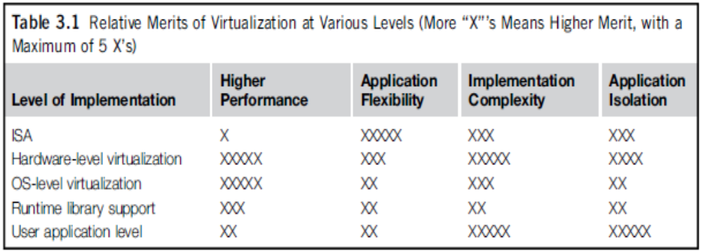
Relative Merits of Different Approaches

Slide 8
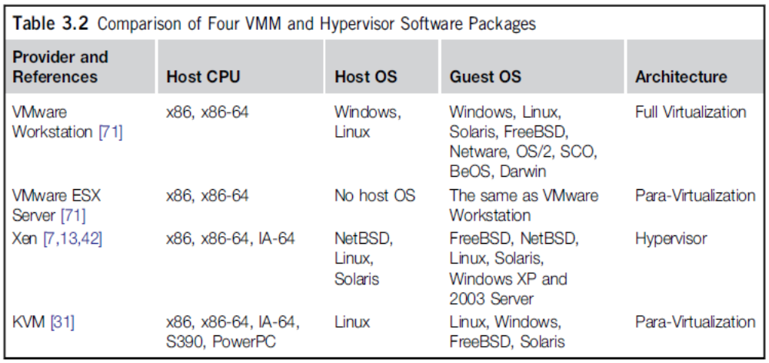
Four VMM and Hypervisor Software Packages

Slide 9
Virtualization at ISA (Instruction Set Architecture) level:
Emulating a given ISA by the ISA of the host machine.
e.g, MIPS (Microprocessor without Interlocked Pipelined Stages) binary code can run on an x-86-based host machine with the help of ISA emulation.
  Typical systems: Bochs, Crusoe, Quemu, BIRD, Dynamo
Advantage:
  It can run a large amount of legacy binary codes written for various processors on any given new hardware host machines
  best application flexibility
Shortcoming & limitation:
  One source instruction may require tens or hundreds of native target instructions to perform its function, which is relatively slow.
  V-ISA requires adding a processor-specific software translation layer in the complier.

Slide 10
Virtualization at Hardware Abstraction level:
Virtualization is performed right on top of the hardware.
It generates virtual hardware environments for VMs, and manages the underlying hardware through virtualization.
Typical systems: VMware, Virtual PC, Denali, Xen
Advantage:
Has higher performance and good application isolation
Shortcoming & limitation:
Very expensive to implement (complexity)

Slide 11
Virtualization at Operating System (OS) level:
It is an abstraction layer between traditional OS and user applications.
This virtualization creates isolated containers on a single physical server and the OS-instance to utilize the hardware and software in datacenters.
Typical systems: Jail / Virtual Environment / Ensim's VPS / FVM
Advantage:
Has minimal startup/shutdown cost, low resource requirement, and high scalability; synchronize VM and host state changes.
Shortcoming & limitation:
All VMs at the operating system level must have the same kind of guest OS
Poor application flexibility and isolation.

Slide 12
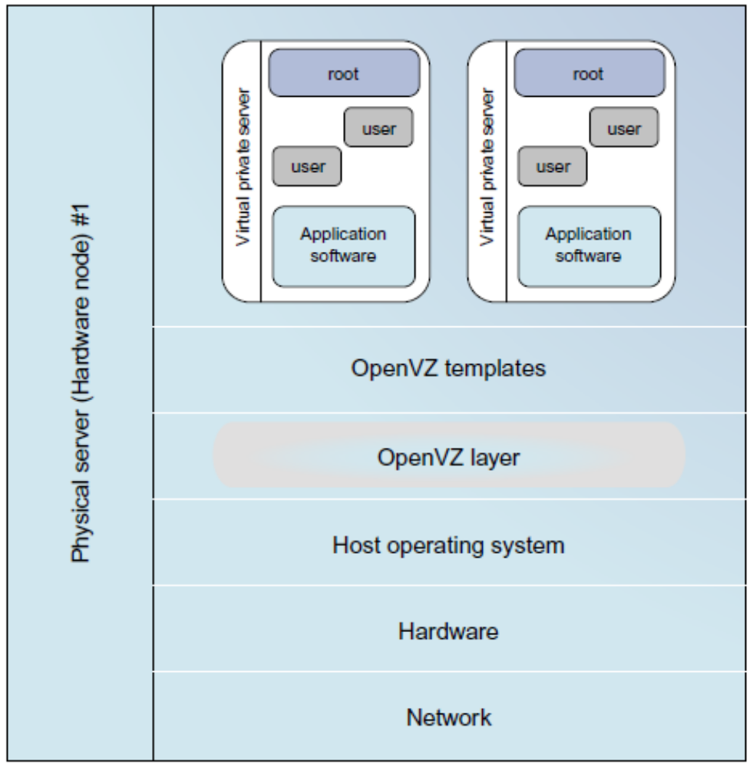
Virtualization at OS Level
The OpenVZ virtualization layer inside the host OS, which provides some OS images to create VMs quickly.

Slide 13
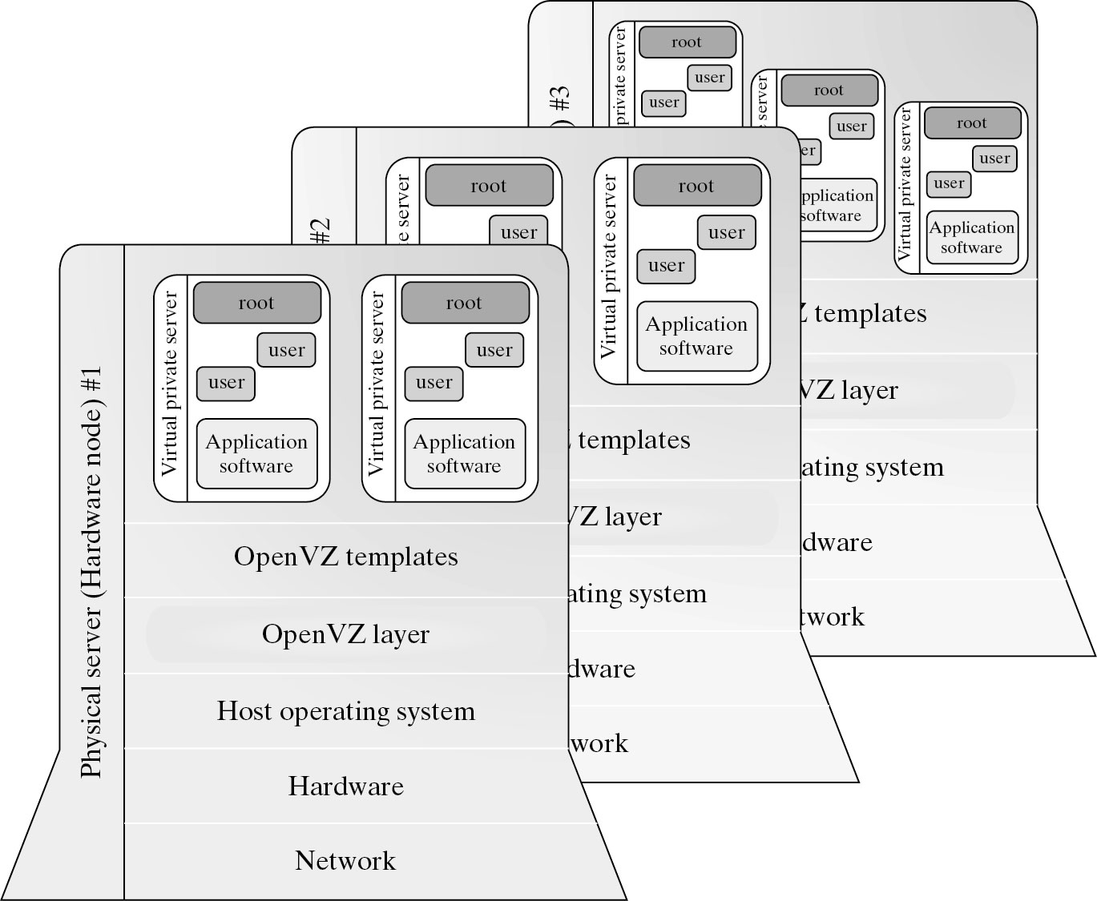
Virtualization for Linux and Windows NT Platforms

Slide 14

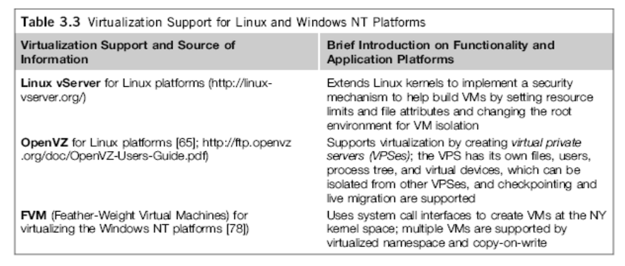

Slide 15
Library Support level:
It creates execution environments for running alien programs on a platform rather than creating VM to run the entire operating system.
It is done by API call interception and remapping.
Typical systems: Wine, WAB, LxRun , VisualMainWin
Advantage:
It has very low implementation effort
Shortcoming & limitation:
poor application flexibility and isolation

Slide 16
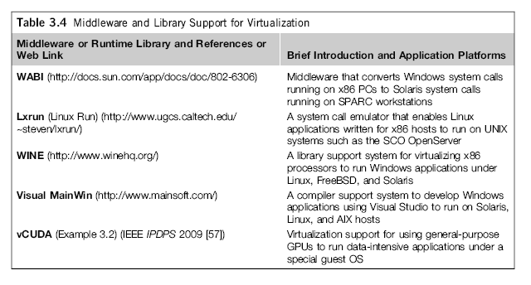
Virtualization with Middleware/Library Support

Slide 17
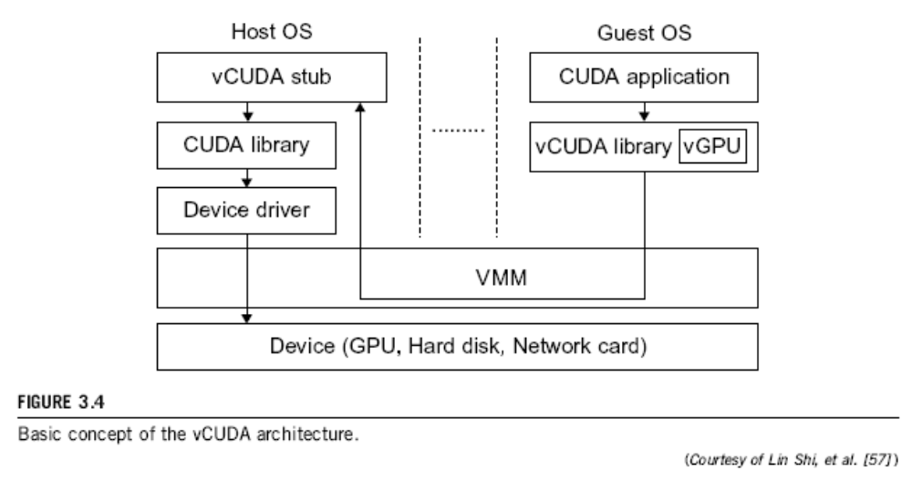
The vCUDA (Compute Unified Device Architecture) for Virtualization of GPGPU

Slide 18
User-Application level:
It virtualizes an application as a virtual machine.
This layer sits as an application program on top of an operating system and exports an abstraction of a VM that can run programs written and compiled to a particular abstract machine definition.
Typical systems: JVM , NET CLI , Panot
Advantage:
has the best application isolation
Shortcoming & limitation:
low performance, low application flexibility and high implementation complexity.

Slide 19
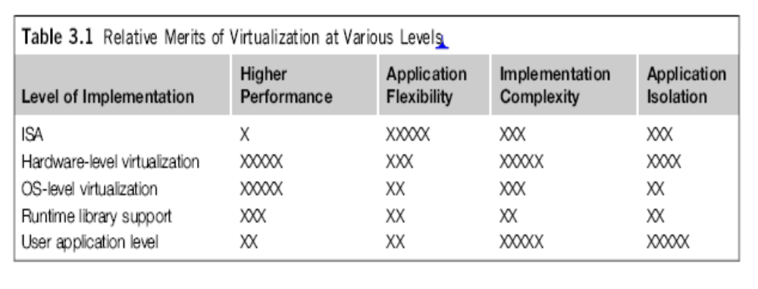
More Xs mean higher merit

Slide 20
Hypervisor
A hypervisor is a hardware virtualization technique allowing multiple operating systems, called guests to run on a host machine. This is also called the Virtual Machine Monitor (VMM).
Type 1: bare metal hypervisor
sits on the bare metal computer hardware like the CPU, memory, etc.
All guest operating systems are a layer above the hypervisor.
The original CP/CMS hypervisor developed by IBM was of this kind.
Type 2: hosted hypervisor
Run over a host operating system.
Hypervisor is the second layer over the hardware.
Guest operating systems run a layer over the hypervisor.
The OS is usually unaware of the virtualization

Slide 21
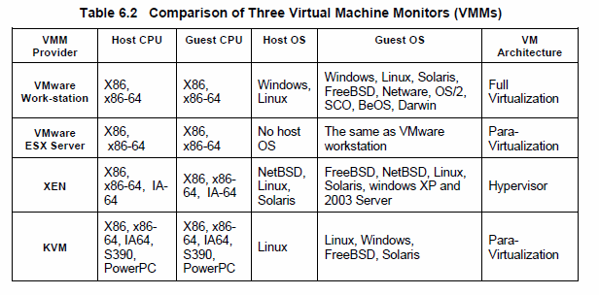
Major VMM and Hypervisor Providers

Slide 22
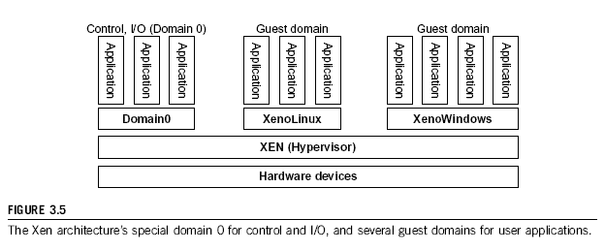
The XEN Architecture (1)

Slide 23
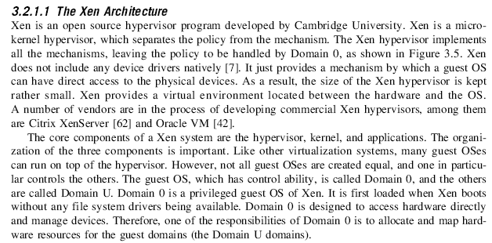
The XEN Architecture (2)

Slide 24
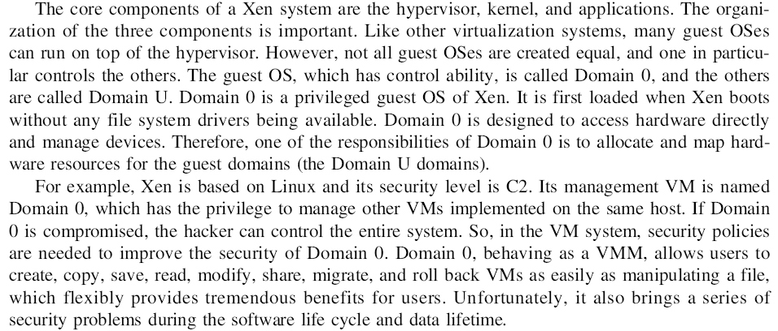
The XEN Architecture (3)

Slide 25
Full Virtualization vs. Para-Virtualization
Full virtualization
Does not need to modify guest OS, and critical instructions are emulated by software through the use of binary translation.
VMware Workstation applies full virtualization, which uses binary translation to automatically modify x86 software on-the-fly to replace critical instructions.
Advantage: no need to modify OS.
Disadvantage: binary translation slows down the performance.
Para virtualization
Reduces the overhead, but cost of maintaining a paravirtualized OS is high.
The improvement depends on the workload.
Para virtualization must modify guest OS, non-virtualizable instructions are replaced by hypercalls that communicate directly with the hypervisor or VMM.
Para virtualization is supported by Xen, Denali and VMware ESX.

Slide 26
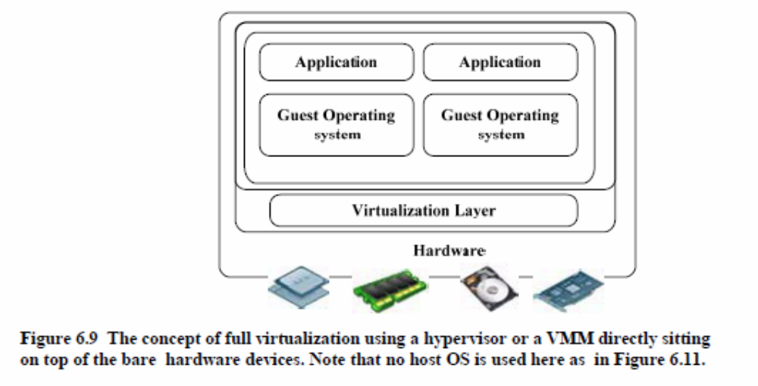
Full Virtualization

Slide 27
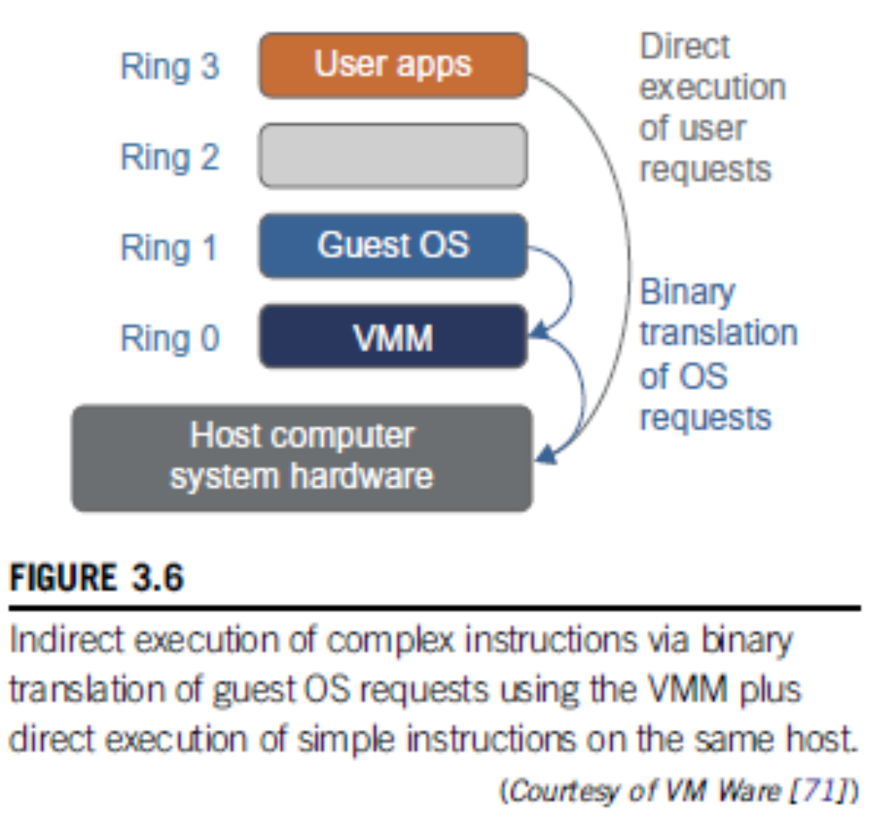
Binary Translation of Guest OS Requests using a VMM:

Slide 28
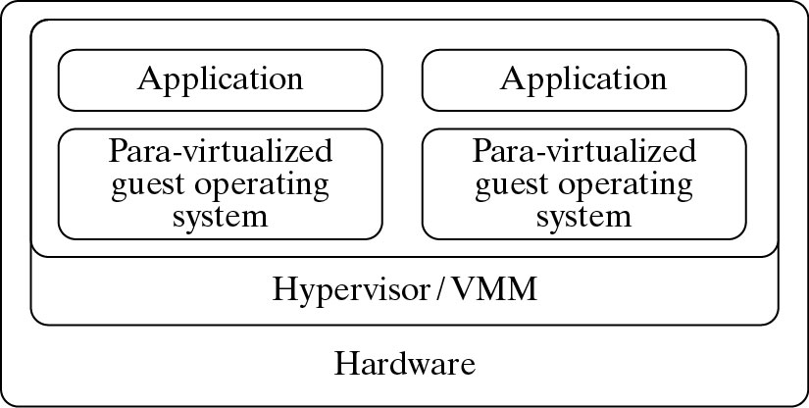
Para- Virtualization with Compiler Support.
The KVM builds offers kernel-based VM on the Linux
platform, based on para-virtualization

Slide 29
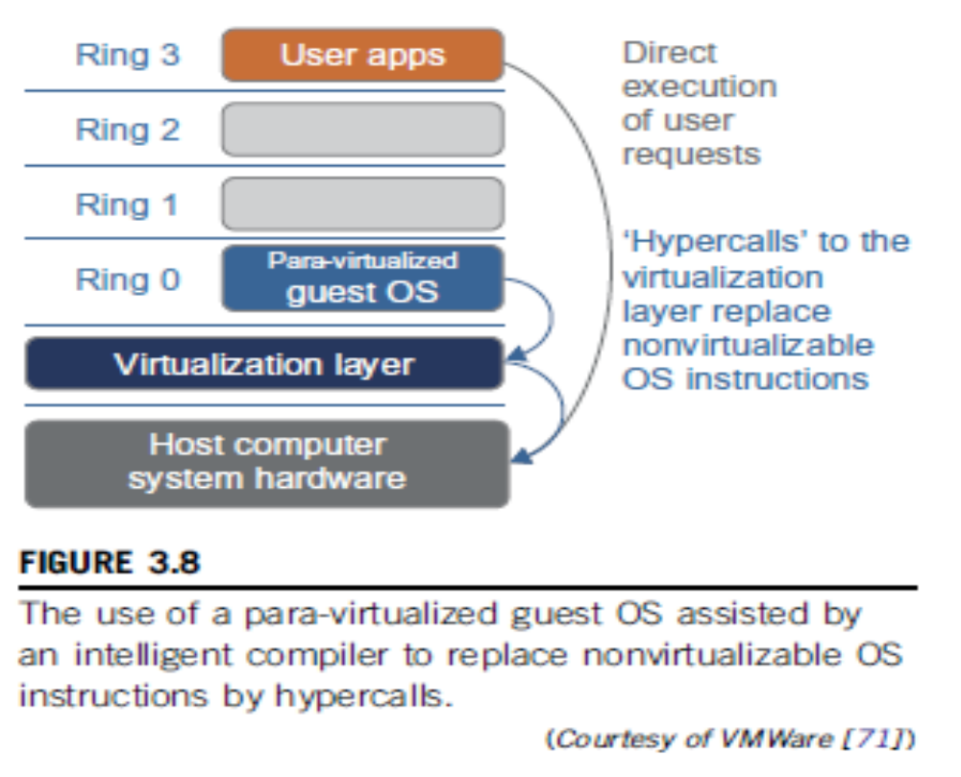

Slide 30
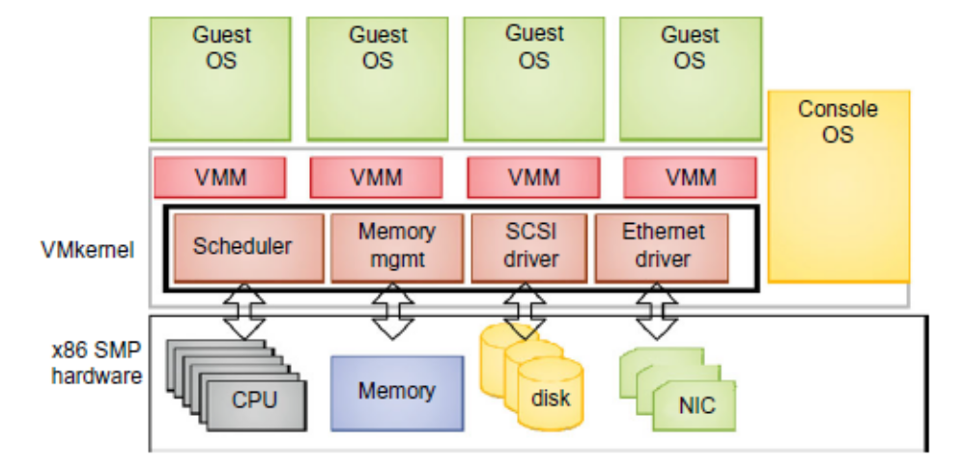
VMWare ESX Server for Para-Virtualization

Slide 31
VIRTUALIZATION OF CPU, MEMORY, AND I/O DEVICES
Hardware Support for Virtualization
  If there is no protection mechanism in a processor, all instructions from different processes will access the hardware directly and cause a system crash.
  All processors have at least two modes, user mode and supervisor mode.
  Many hardware virtualization products available
  KVM (Kernel-based Virtual Machine) is a Linux kernel virtualization infrastructure. KVM can support hardware-assisted virtualization and paravirtualization by using the Intel VT-x or AMD-v and VirtIO framework, respectively.

Slide 32
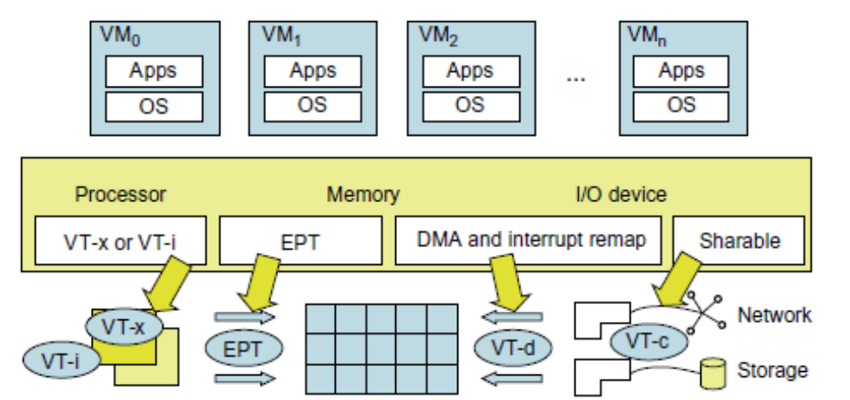
Hardware Support for Virtualization in the Intel x86 Processor

Slide 33
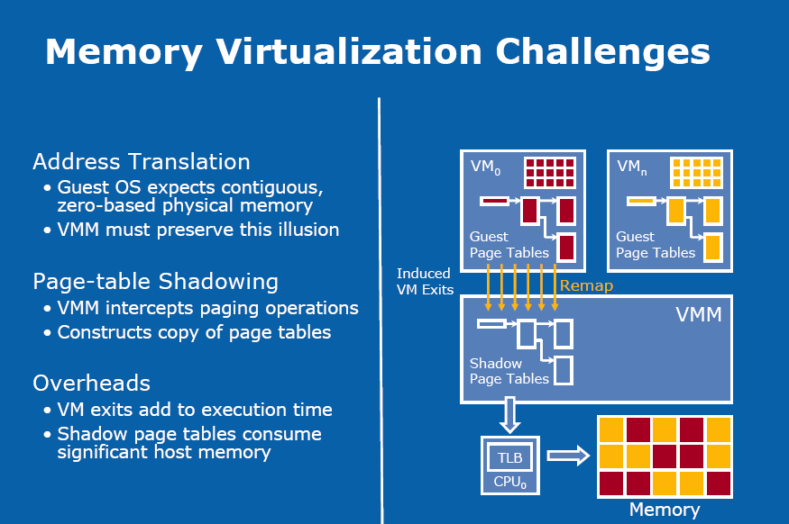

Slide 34
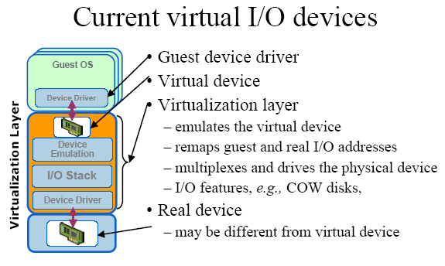

Slide 35
Conclusions on CPU, Memory
and I/O Virtualization :
CPU virtualization demands hardware-assisted traps of
sensitive instructions by the VMM
Memory virtualization demands special hardware support
(shadow page tables by VMWare or extended page table by
Intel) to help translate virtual address into physical address
and machine memory in two stages.
I/O virtualization is the most difficult one to realize due to
the complexity if I/O service routines and the emulation
needed between the guest OS and host OS.

Slide 36
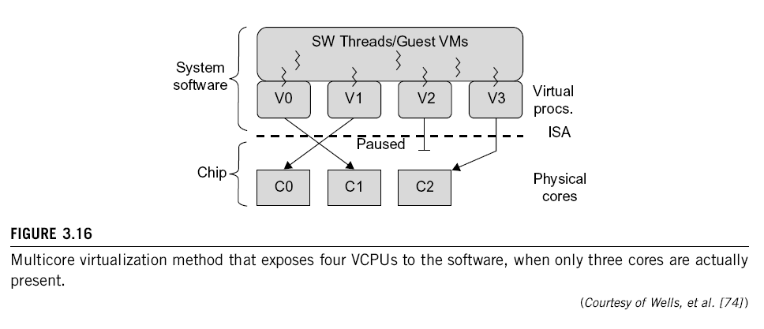
Multi-Core Virtualization:
VCPU vs. traditional CPU
Figure 3.16 Four VCPUs are exposed to the software, only three cores are actually present. VCPUs V0, V1, and V3 have been transparently migrated, while VCPU V2 has been transparently suspended. (Courtesy of Wells, et al., “Dynamic Heterogeneity and the Need for Multicore Virtualization”, ACM SIGOPS Operating Systems Review, ACM Press, 2009 [68] )

Slide 37
Virtual Cores vs. Physical Processor Cores
Physical cores | Virtual cores
The actual physical cores present in the processor. | There can be more virtual cores visible to a single OS than there are physical cores.
More burden on the software to write applications which can run directly on the cores. | Design of software becomes easier as the hardware assists the software in dynamic resource utilization.
Hardware provides no assistance to the software and is hence simpler. | Hardware provides assistance to the software and is hence more complex.
Poor resource management. | Better resource management.
The lowest level of system software has to be modified. | The lowest level of system software need not be modified.

Slide 38
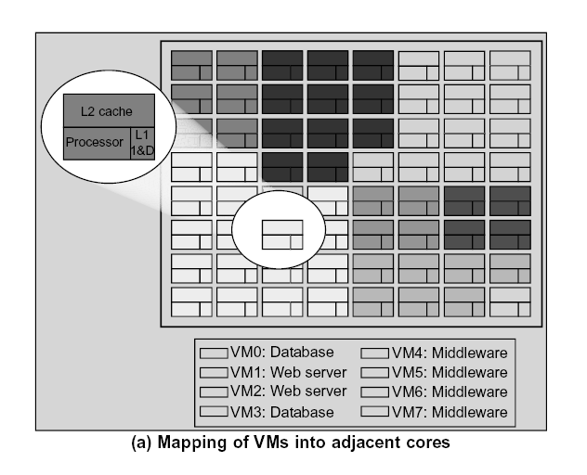
(Courtesy of Marty and Hill, 2007)

Slide 39
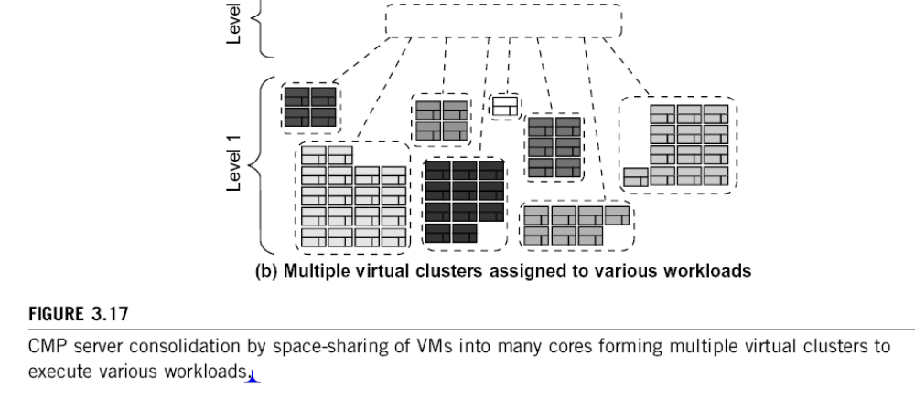
Virtual Clusters in Many Cores
Space Sharing of VMs -- Virtual Hierarchy
(Courtesy of Marty and Hill, 2007)

Slide 40
Virtual Cluster Characteristics
The virtual cluster nodes can be either physical or virtual machines. Multiple VMs
running with different OSs can be deployed on the same physical node.
A VM runs with a guest OS, which is often different from the host OS, that manages the resources in the physical machine, where the VM is implemented.
The purpose of using VMs is to consolidate multiple functionalities on the same server. This will greatly enhance the server utilization and application flexibility.
VMs can be colonized (replicated) in multiple servers for the purpose of promoting distributed parallelism, fault tolerance, and disaster recovery.
The size (number of nodes) of a virtual cluster can grow or shrink dynamically, similarly to the way an overlay network varies in size in a P2P network.
The failure of any physical nodes may disable some VMs installed on the failing nodes. But the failure of VMs will not pull down the host system.

Slide 41
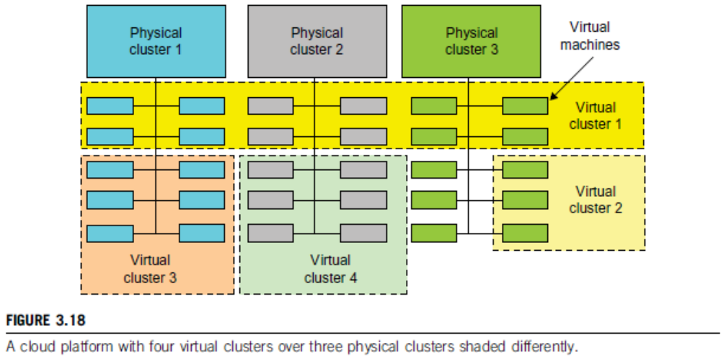
Virtual Clusters vs. Physical Clusters

Slide 42
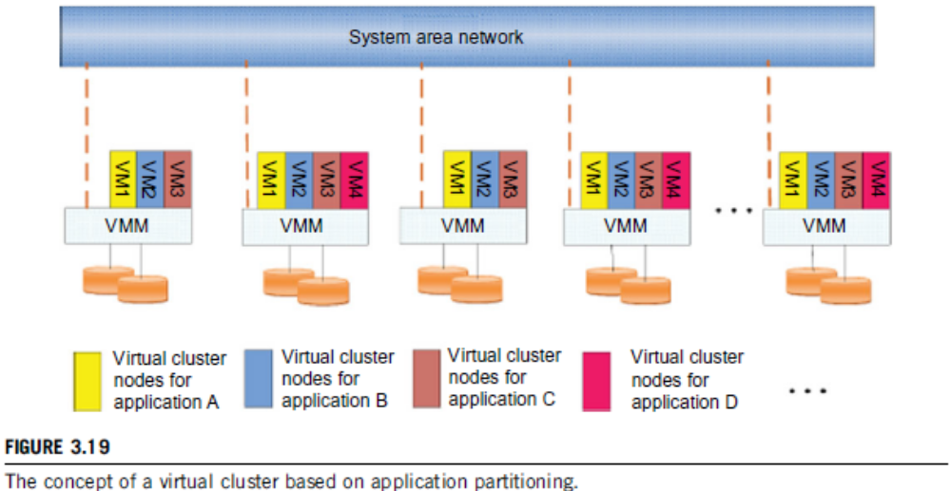
Virtual cluster based on application partitioning or customization.

Slide 43
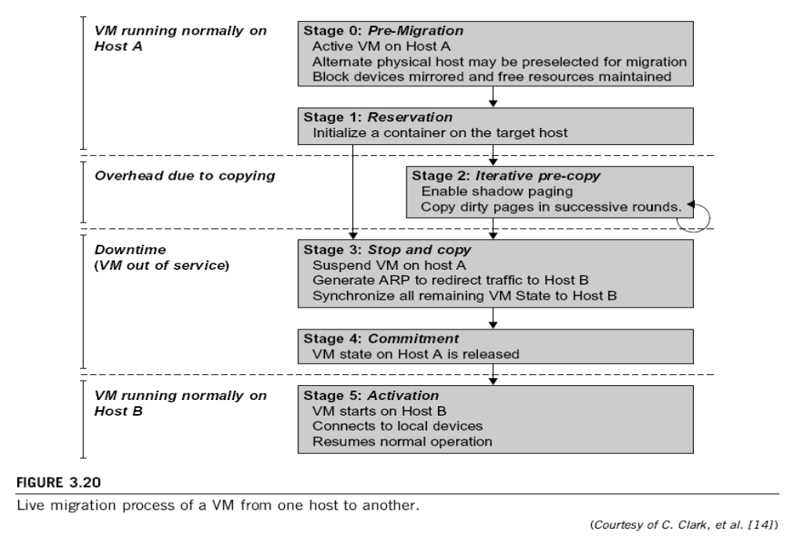
Live Migration of Virtual Machines

Slide 44
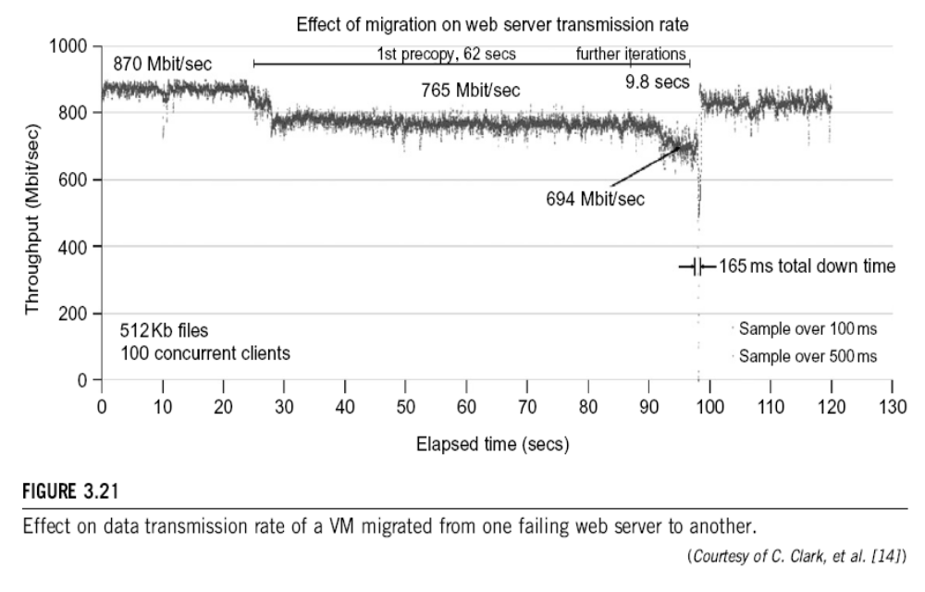

Slide 45
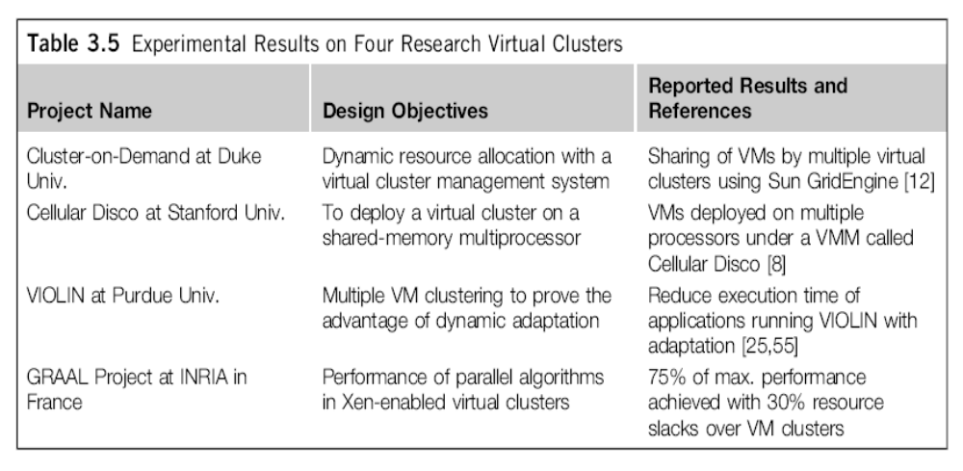
Virtual Cluster Projects

Slide 46
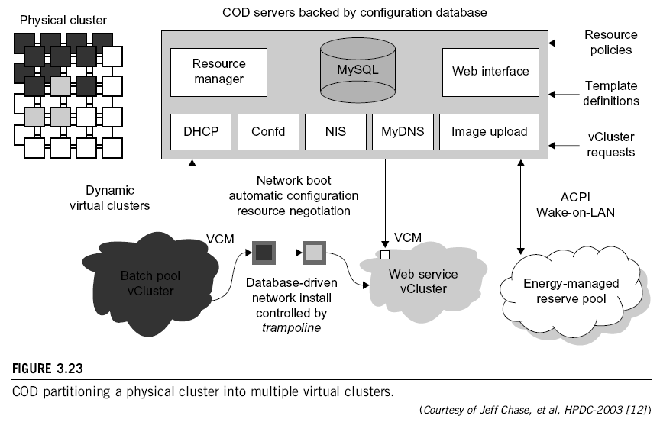

Slide 47
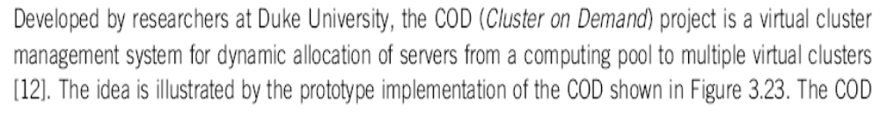
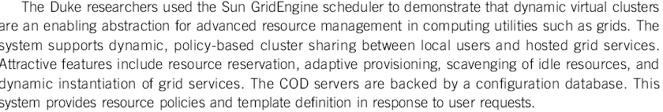
Cluster-on-Demand (COD Project)
at Duke University

Slide 48
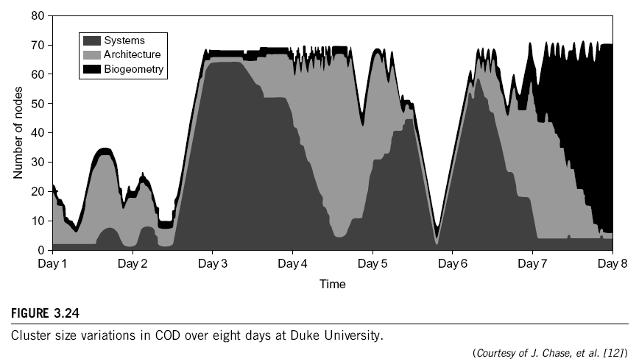

Slide 49
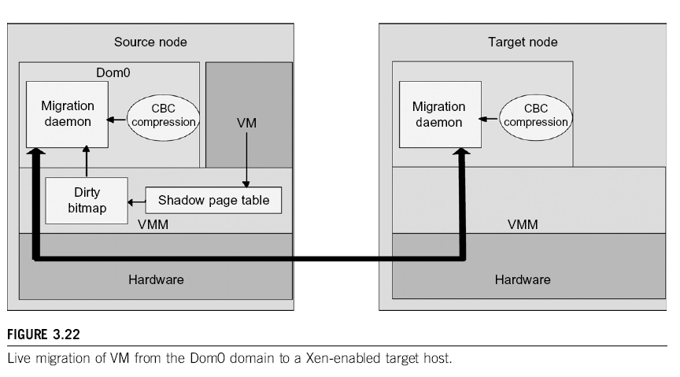

Slide 50
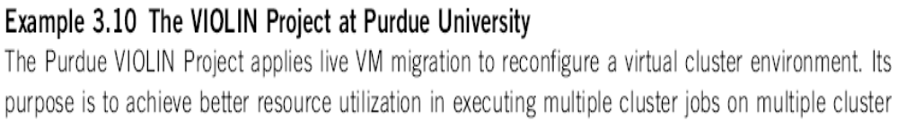
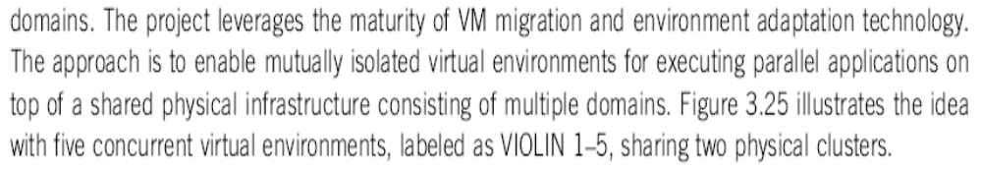
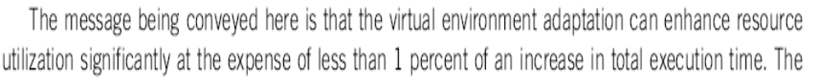
VIOLIN Project at Purdue University

Slide 51
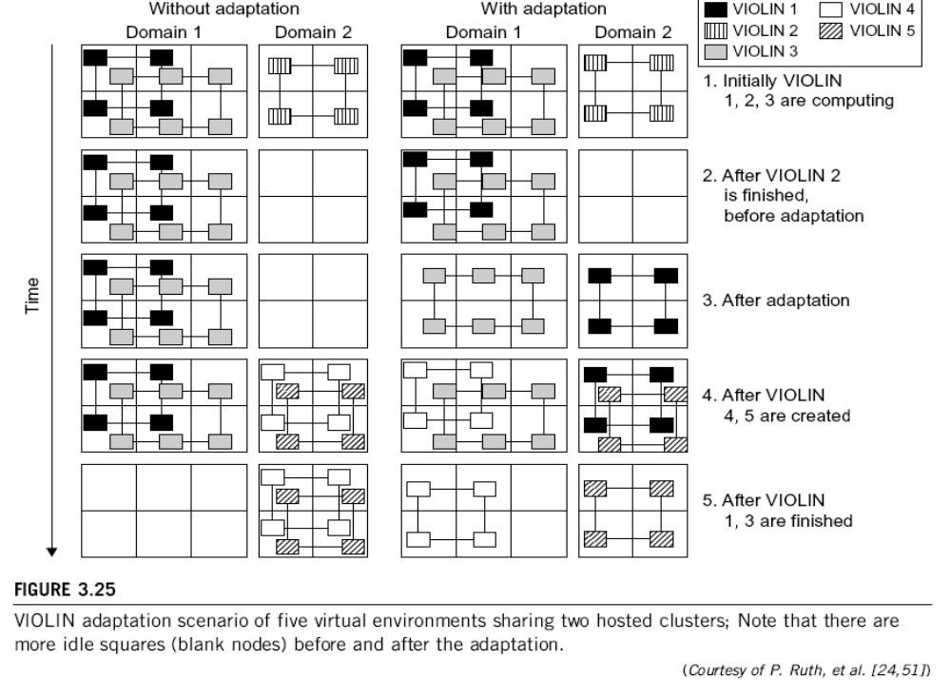

Slide 52
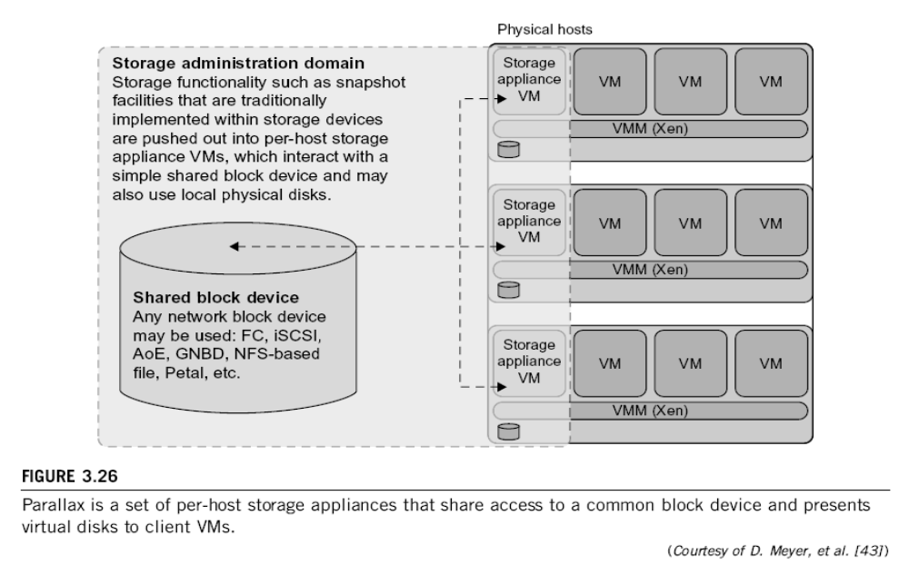
Parallax for VM Storage Management

Slide 53
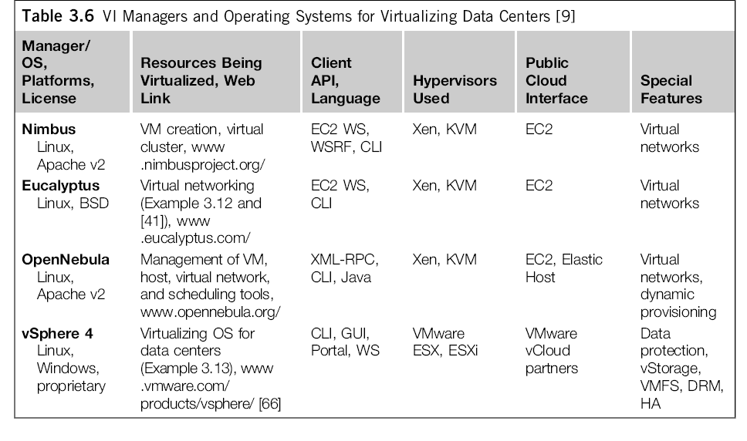
Cloud OS for Building Private Clouds

Slide 54
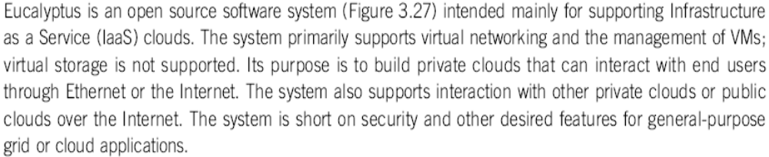
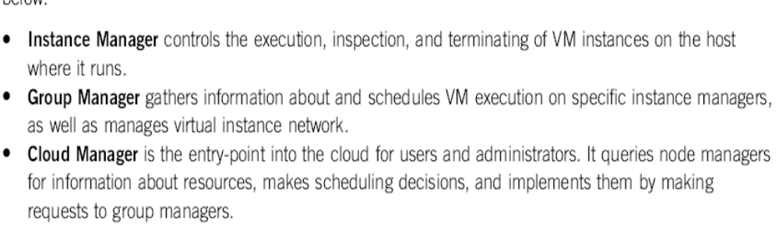
Eucalyptus : An Open-Source OS for Setting Up and Managing Private Clouds

Slide 55
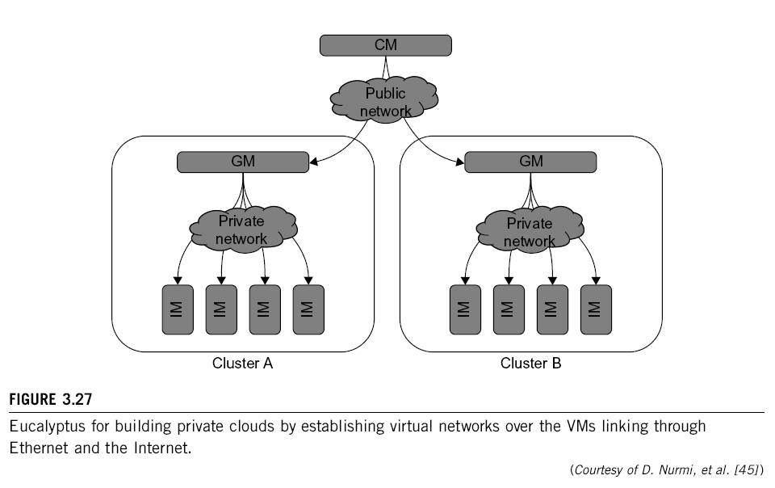

Slide 56
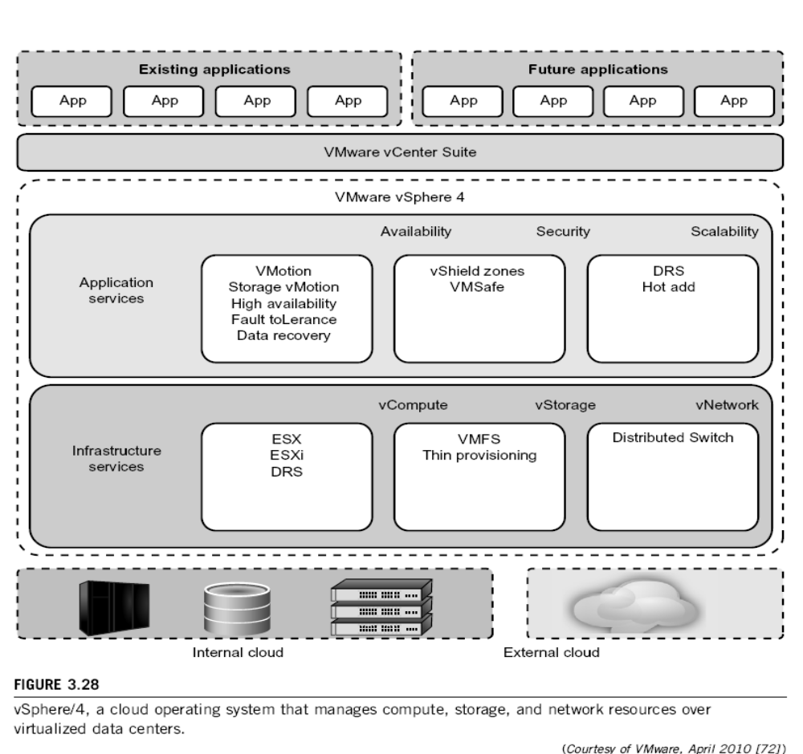

Slide 57


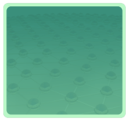



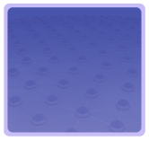

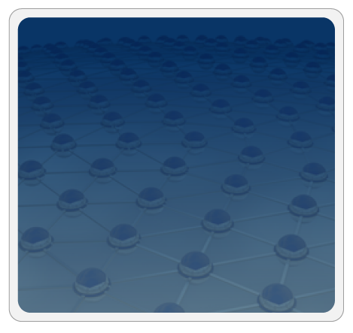



Trusted Zones for VM Insulation
Insulate infrastructure from Malware, Trojans and cybercriminals
Anti-malware
Federate identities with public clouds
Identity federation
Cybercrime intelligence
Strong authentication
APP
APP
Tenant #2
OS
OS
Control and isolate VM in the virtual infrastructure
Virtual Infrastructure
Insulate information
from other tenants
Virtual network security
Data loss prevention
APP
APP
Tenant #1
OS
OS
Virtual Infrastructure
Insulate information from cloud providers’ employees
Encryption & key mgmt
Access Mgmt
Segregate and control user access
Cloud Provider
Tokenization
Security Info. & Event Mgmt
Physical Infrastructure
GRC
Enable end to end view of security events
and compliance across infrastructures
(Courtesy of L. Nick, EMC 2008)

